Slide 1


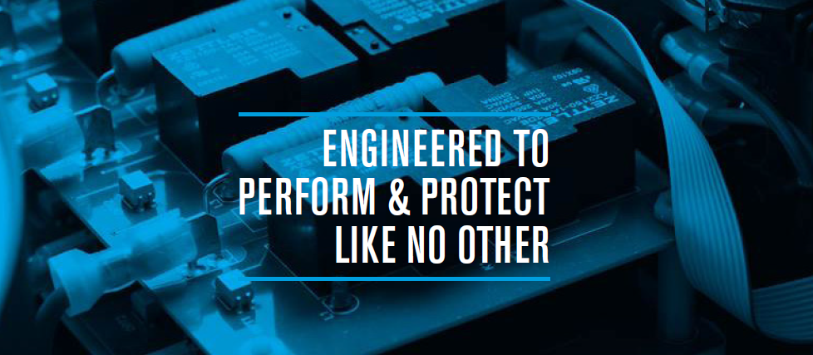
Torus Power Inc.
Notes:
Welcome
Thanks for attending

Slide 2
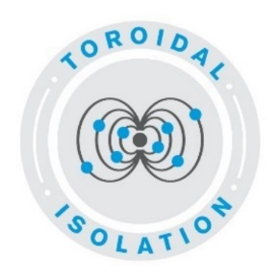
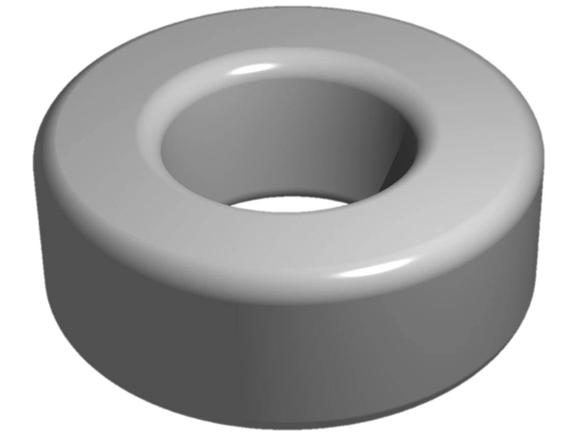
Torus Power Inc.
System Reliability
Incoming Power
(Primary Winding)
To AV System (Secondary Winding)
Primary current Ip
Secondary current Is
+
+
Primary
Voltage
Secondary Voltage
-
-
Magnetic
Flux
Power
*Simplified Drawing
Notes:
Part 1: System Reliability
How does clean power add reliability to an A/V system?
Most people understand that there are many problems on the incoming power line.
Noise/distortion/artifacts/atmospheric events can all cause problems with the operation of sensitive electronic components
Can clean power really help products perform better and work more reliably? Yes, it can.
Let’s explore this a bit more…
Torus Power is the world’s leading company in clean power delivery for A/V systems through our fundamental technology of toroidal isolation.
Toroidal isolation is the process of using magnetics to electrically disconnect your av system from the incoming power and providing a clean power source to the components in your A/V system.
Let me show you…
Using an isolation transformer adds reliability to your A/V system in two ways…
Operational reliability: communication between components is not disturbed by powerline issues – flawless operation of keypad controls and microprocessors.
Long-term equipment reliability: When the power supplies in the equipment are trying to compensate for electrical issues they heat up and this shortens the equipment life and leads to microprocessor and power supply failures over time.
Toroidal isolation is the most effective way of eliminating powerline problems and providing a clean power platform for your high-performance A/V system.

Slide 3
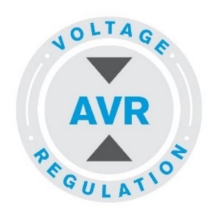
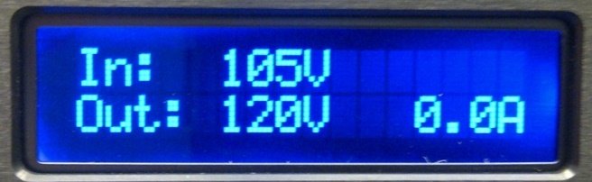
Torus Power Inc.
Automatic Voltage Regulation
AVR Maintains Consistent output voltage of
120V +/-5V
AVR
135V
125V
Accepts input voltage from
85V to 135V
Automatic Shut-Down when
voltage exceeds threshold (Email Notification)
Automatic Start-Up when voltage is within normal threshold
AVR
Input
Output
115V
85V
Notes:
Part 2: Automatic Voltage Regulation
Now let’s look at how we deal with fluctuations and inconsistencies on the incoming powerline.
Surges/Spikes/Over Voltage/Under Voltage/ Sags/Transients – These are all problems that can occur in the electrical voltage supply that can cause problems/failures in system components.
When the power supply in an electronic component that is not designed for wide voltage fluctuations is asked to compensate for this it creates heat that can shorten the life of the component.
Regulating the voltage powering the sensitive equipment can solve this problem and add years of life to your system components.
Here’s how Torus Power solves the problem…
Torus Power transformers can be used to step up/down the voltage by adjusting the size of the primary winding compared to the secondary winding. We use a multi-tapped transformer that can adjust to the voltage fluctuations and ensure that the connected equipment is not exposed to these damaging conditions. When the voltage changes, the Torus Power AVR unit senses the change and automatically selects the best input tap to compensate and maintain stable voltage at the output.
Toroidal isolation with automatic voltage regulation can help ensure optimum performance for your high-performance A/V system.

Slide 4
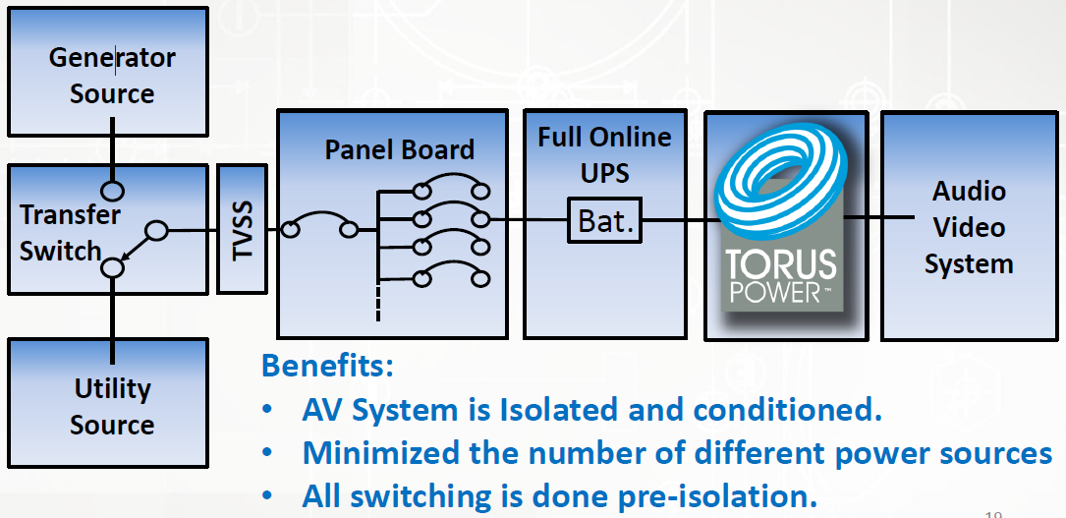
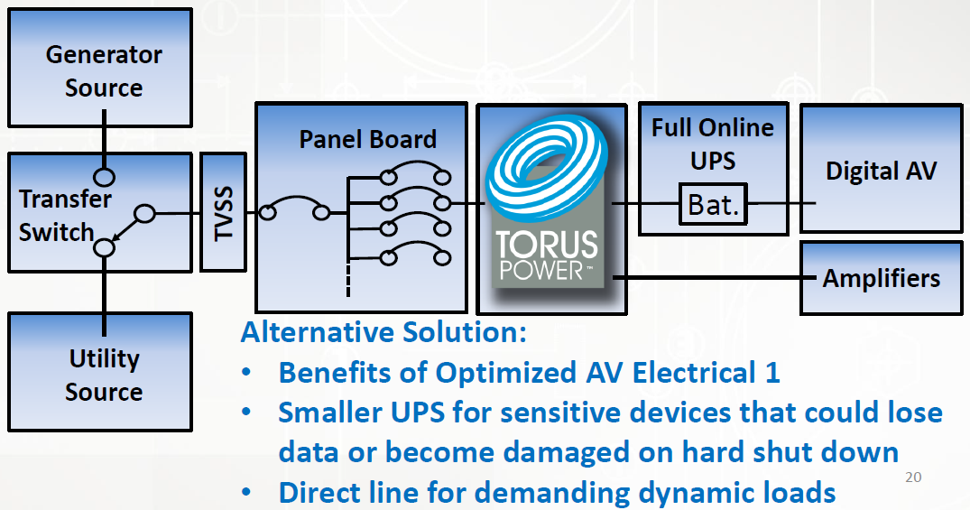
Torus Power Inc.
How to create a power ecosystem
#1
#2
Notes:
Part 3: How to create a robust power ecosystem
Power and grounding are the heart of any electronic system. Keeping distortion, harmonics, normal mode, and common model noise to a minimum is necessary for reliable operation.
To control power quality, we must look at the source of power and how it is being distributed to the system. Ideally, loads will be divided into three categories…
Motor Loads: Refrigeration, air conditioning, water pumps, etc.
Lighting/Convenience Loads: dimming circuits, coffee makers, microwaves, etc.
Sensitive Electronic (Critical) Loads: Isolate control systems and Audio Video equipment.
Properly engineered and installed grounding system
Triple shielded isolation transformer with RF filtering + Spike/Surge protection
One larger isolation transformer vs. power units in each rack (same ground potential and electrical phase)
Breaker panel with bolt-in breakers, copper bus bars, and isolated ground bar
Hospital grade receptacles
Stranded wire to receptacles. Min 12 gauge to each 20A circuit (recommend up-gauge)
Locate isolation transformer as close as possible to AV system components… studio/theatre applications less than 50’ | Audiophile applications less than 20’
Add a UPS to protect network equipment and critical devices…
These recommendations should comprise the foundation of any high-performance AV system.

Slide 5
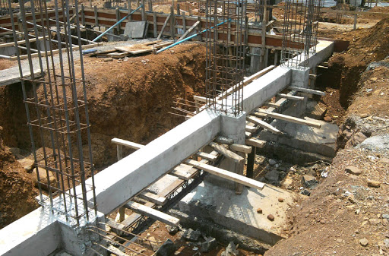
Torus Power Inc.
Power as a foundation
A well engineered system starts with clean power
High performance systems require strong foundations
Specify power with Network as the foundation needed to properly support the system
Everything works better with clean power and a solid network
Power belongs at the beginning of the quote – not at the end!
Notes:
Part 4: Power as a foundational product
When it comes to AV systems, we must consider that every component in the system is powered by electricity and subject to noise and other problems that exist on the power line. We know that isolating the AV system from the electrical grid provides increased reliability and better performance, but let’s take that a step further…
Every high-performance AV & Control system needs two well designed systems for flawless operation:
Network: We can easily imagine the operational problems we would have by using a flawed network system for control operations. To avoid these problems, we start with a robust network system.
Electrical Power: Noise and other problems on the electrical line can cause operational problems, system reliability issues, and even component failures. We can eliminate these problems by isolating the power that is feeding the AV and control system.
Let’s think of these systems in terms of building a house. A well-built house starts with a strong foundation. When designing the foundation of a house, we try to keep water from damaging the building by using proper grading, waterproofing the exterior walls of the foundation, and using drainage tiles to move water away from the foundation.
We need to take a similar approach to high performance AV and control systems. Using a robust network and power isolation as the foundation for high-performance AV and control systems means reliable operation, long-term system reliability, and ultimately, a happy customer!

Slide 6
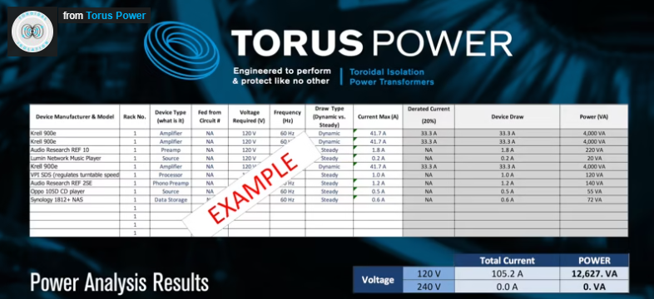
Torus Power Inc.
Specifying Power Solutions
AV System Power Analysis
Notes:
Part 5: How to specify power in a system proposal
When specifying the power requirements for a high-performance AV system in a project proposal we need to start by answering a few questions…
Do you know the total load demand and load signature of the equipment being installed in the project? Have you completed an analysis of the power requirements of the equipment to determine the power delivery requirements?
Have you completed a review of the electrical system in the project location?
Are there any special electrical requirements that need to be installed to handle the load demand for the system?
While it may seem enough to simply supply the system with several dedicated 20A circuits to run an AV System, there is more to it if you intend to deliver a high-performance result.
Care needs to be taken to minimize the distance of wire runs that can increase impedance and inject EMI or RFI noise into the system. In addition, one single clean power source that can handle the full power load will ensure the proper reference to ground for the equipment and that the equipment is operating on the correct phase of the electrical for optimum performance.
Let us help you by completing a power analysis of your AV project before you specify the power delivery equipment
Taking the right steps at the beginning of the project will help ensure the best result at completion.

Slide 7
Torus Power Inc.
Contact Information
How to contact us:
www.toruspower.com
kmain@toruspower.com
rwhitney@toruspower.com
Toll Free: (877) 337-9480

